Slide 1
Big
O
@ Bart B zon

Slide 2


Students pass a package
Students build a house in pairs
O(n)
O(1)
Which takes longer?
And with 7 Billion people?
What scales worst?
Big O?

Slide 3

Students pass a package
Students introduce each other 1 on 1 (after each other)
O(n)
O(n²)
Big O?

Slide 4
How long does something take?
Compiler and programming language
Compiler vs interpreter
https://www.programiz.com/article/difference-compiler-interpreter
Optimisation
https://gcc.gnu.org/onlinedocs/gcc/Optimize-Options.html
Hardware
Pure processing power (e.g. clockspeed)
Parallelization
Multiple cores
Pipelining
FPGA
Algorithm
How does it scale with growing input (Big O)

Slide 5
What is Big O?
Big O, also known as Big O notation, represents an algorithm's worst-case complexity. It uses algebraic terms to describe the complexity of an algorithm.
Big O defines the runtime required to execute an algorithm by identifying how the performance of your algorithm will change as the input size grows. But it does not tell you how fast your algorithm's runtime is.
Big O notation measures the efficiency and performance of your algorithm using time and space complexity. We will focus on time complexity.
https://www.freecodecamp.org/news/big-o-cheat-sheet-time-complexity-chart/

Slide 6
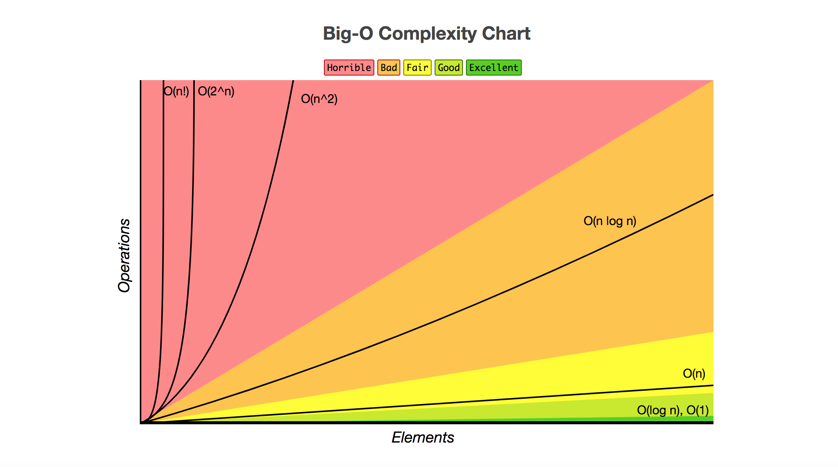
We ignore constant factors
We ignore details related to implementation
We only look at worst case

Slide 7
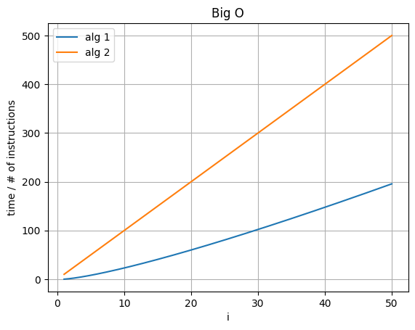
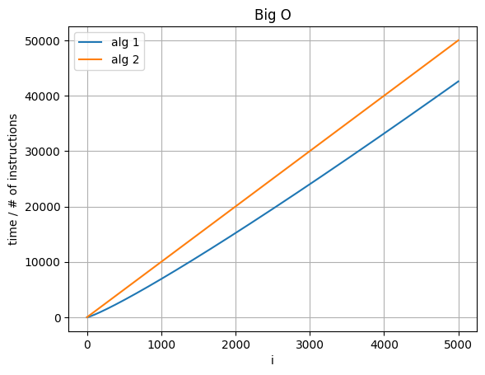
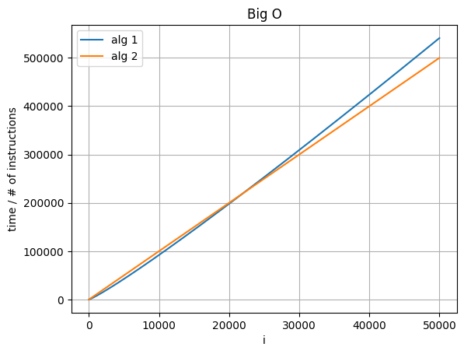
Which is worse?
Which is O(n)?
Which is O(n log n)?

Slide 8
Main Big O types...
Constant : O(1)
Logarithmic : O(log n)
Linear time : O(n)
Linearithmic : O(n log n)
Quadratic : O(n²)
Exponential : O(2^{n})
Factorial : O(n!)

Slide 9
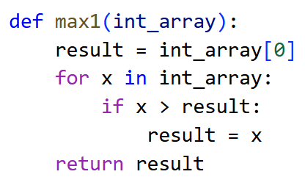
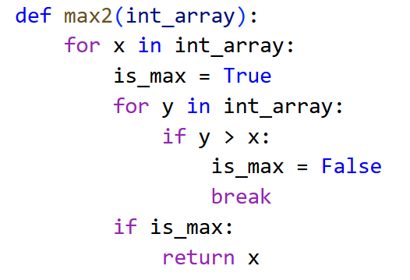
Big O?

Slide 10
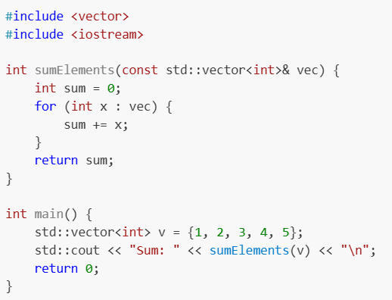
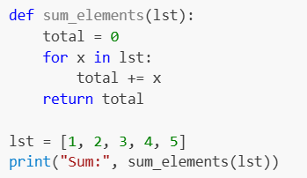
O(n) - Sum
c++
python

Slide 11
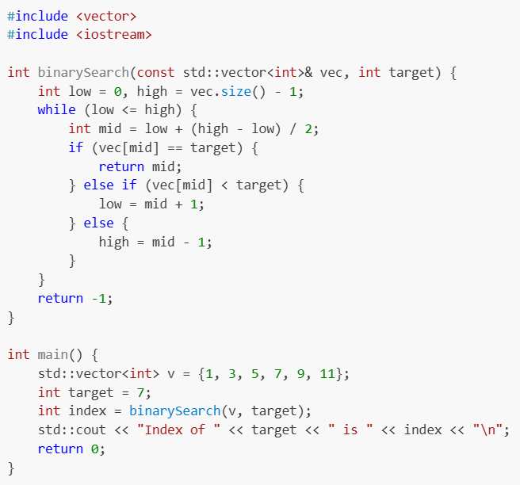
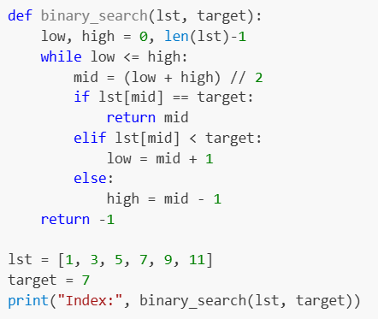
O(log n) – Binary Search
c++
python

Slide 12
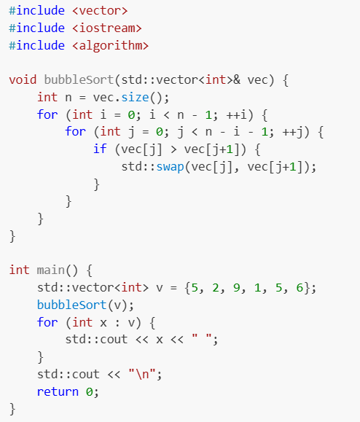
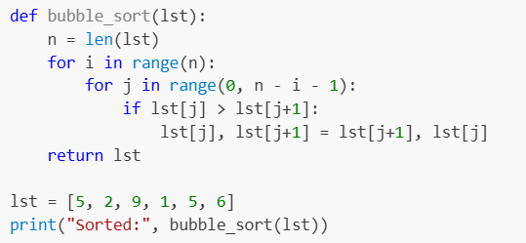
O(n²) – Bubble Sort
c++
python

Slide 13
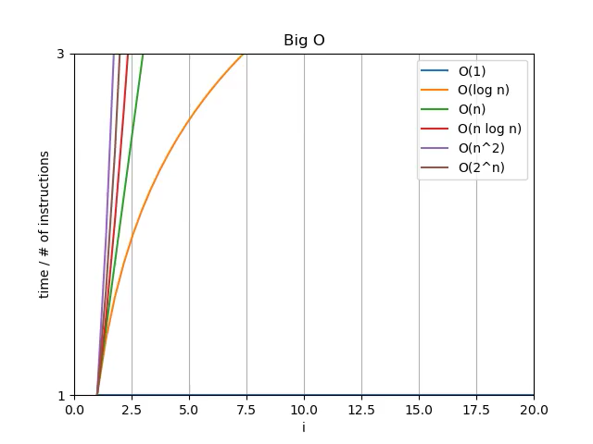
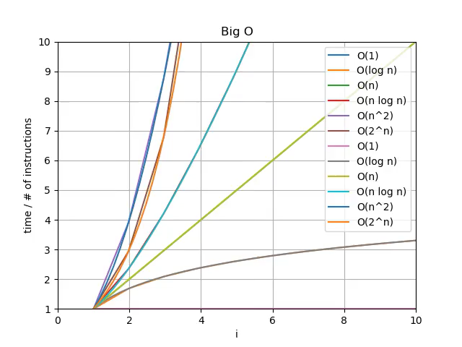

Slide 14
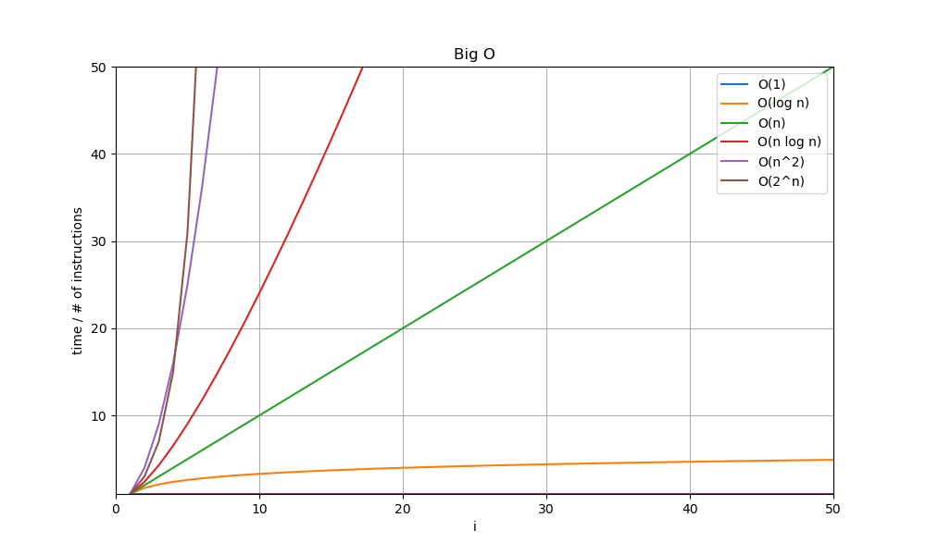
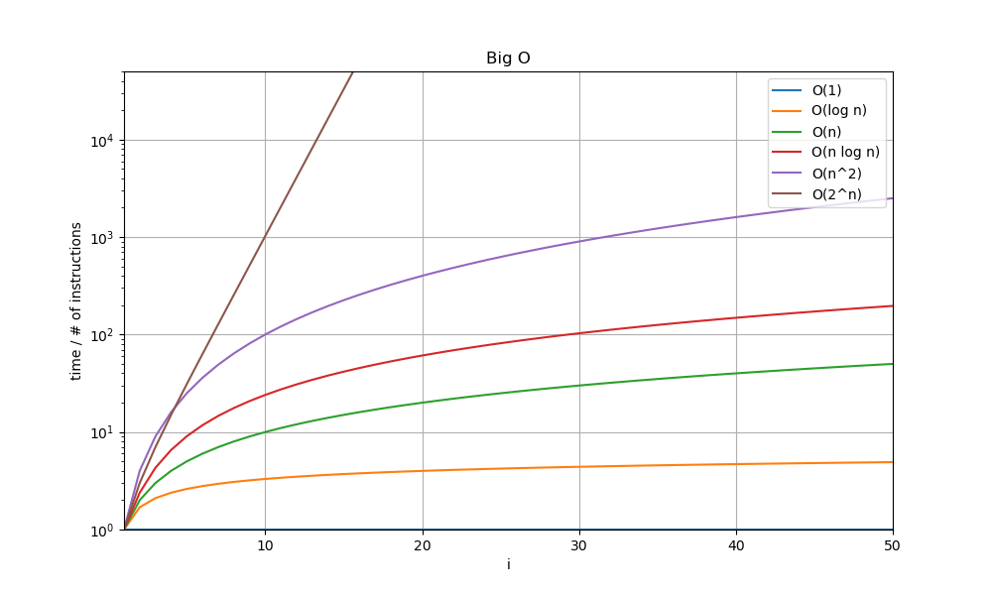
Linear/log plotting

Slide 15
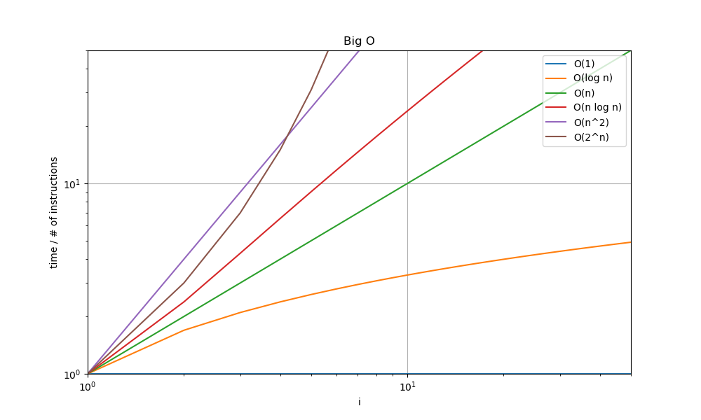
Linear/log/double log

Slide 16
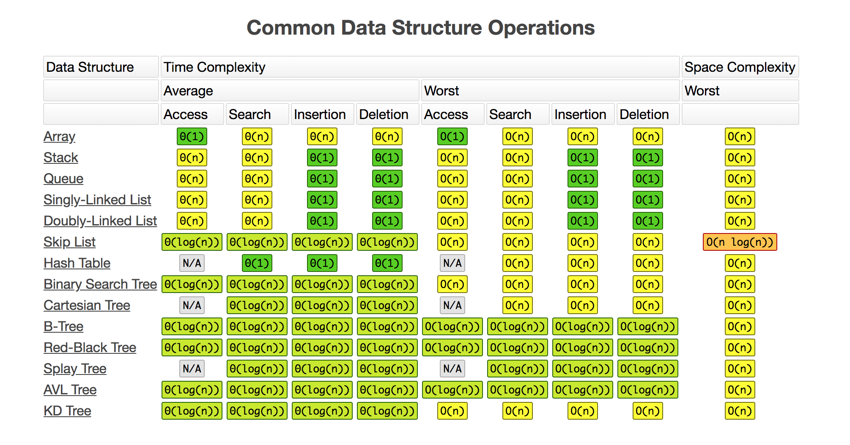
https://jojozhuang.github.io/tutorial/big-o-cheat-sheet/

Slide 17
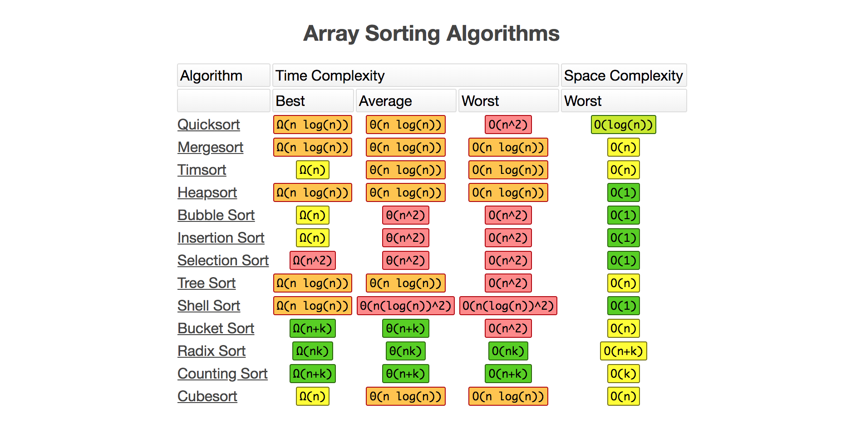
https://jojozhuang.github.io/tutorial/big-o-cheat-sheet/

Slide 18
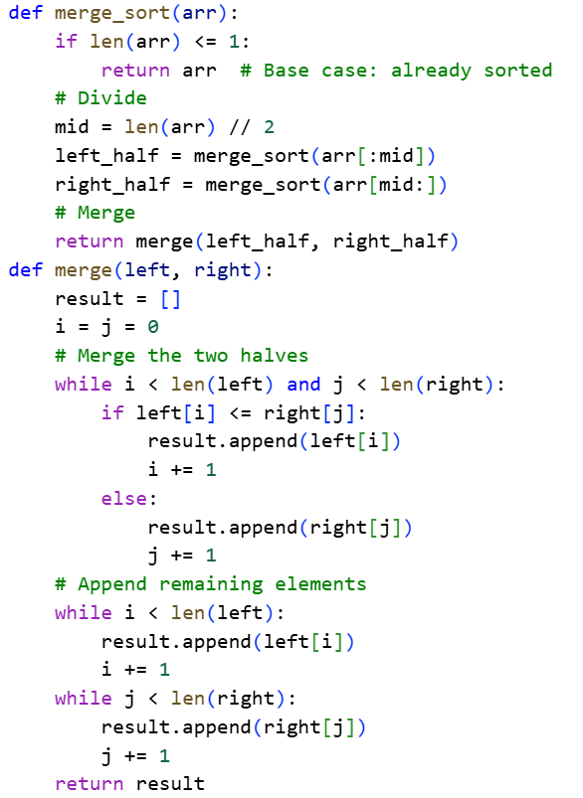
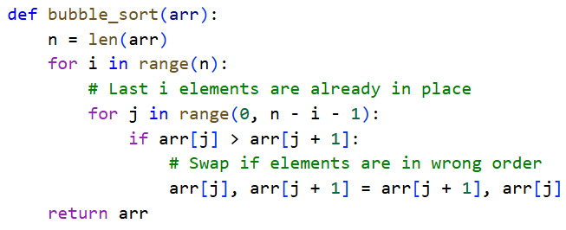
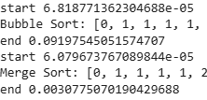
Bubble vs Merge Sort
https://colab.research.google.com/drive/1yu-4EEUHDfq8Bd_B-zxY9x91SdwzIlr2?usp=sharing

Slide 19
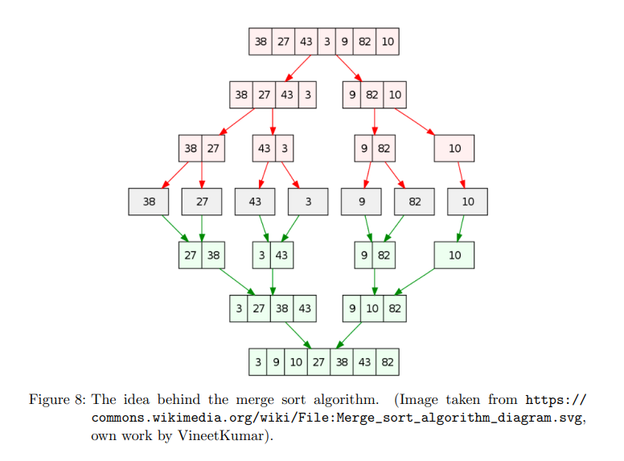

Slide 20
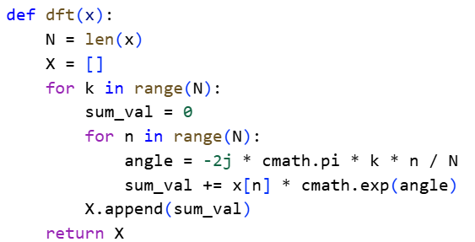
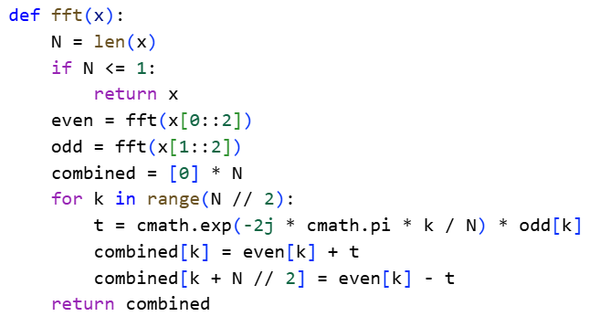
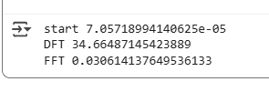
DFT vs FFT
https://colab.research.google.com/drive/1cXlXxxmsZ7oSHuJ64VId-L6vfUOwOROs?usp=sharing

Slide 21
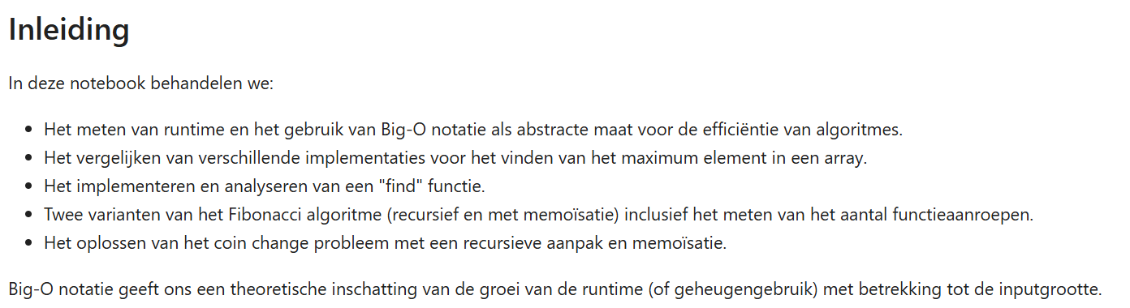
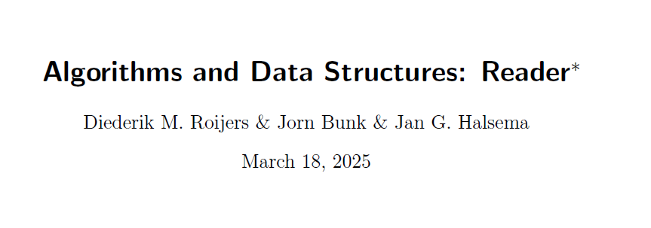
De opdracht!

Slide 22
De opdracht!

Slide 23


Succes!!!!

